Slide 1
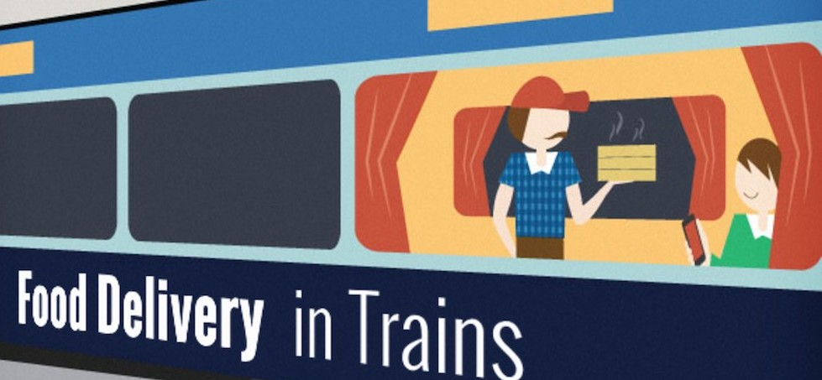
Food delivery on train
Food on Rails

Slide 2




Team Members
Bavani Kumar A
Lokesh K
Gengatharan S
Naveen N A
Dhilip kumar M

Slide 3
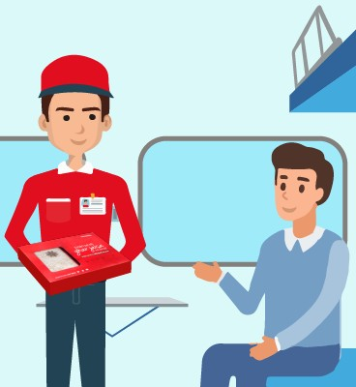
About Our Project
A train-food delivery application where the passenger can order
his/her favourite food from his/her favourite restaurant while not
moving an inch away from the seat.

Slide 4
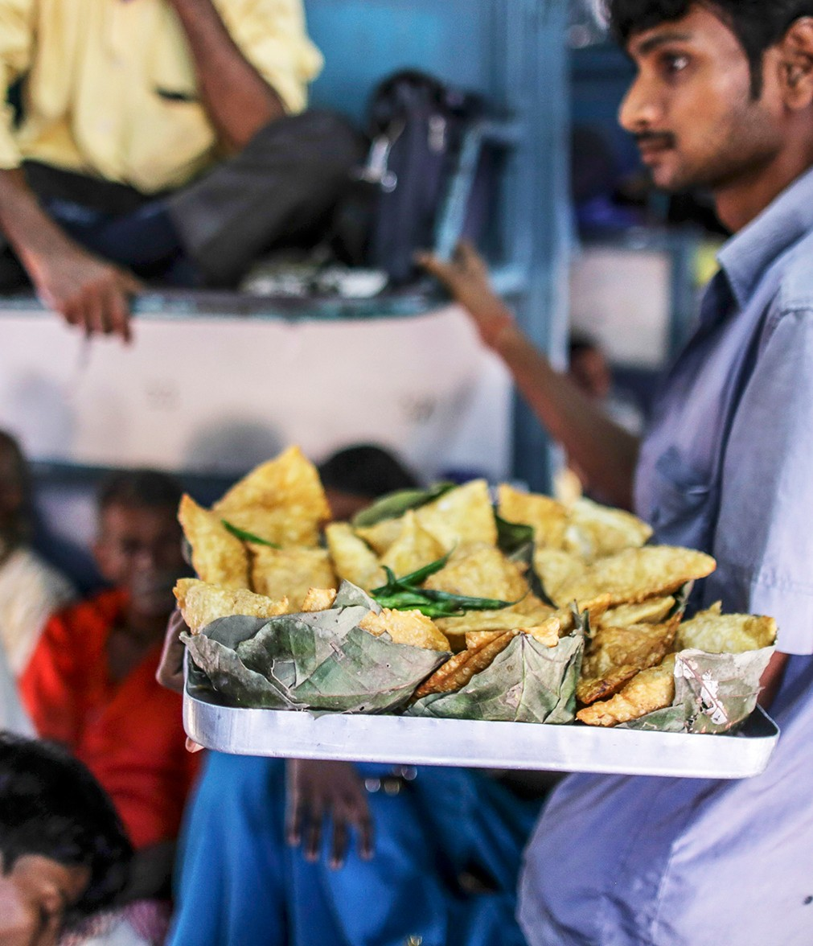

Unhygienic Train Food❌
Tasteless pantry food❌ Expensive IRCTC
foods❌
Restaurant/home-style foods at the train✅

Slide 5
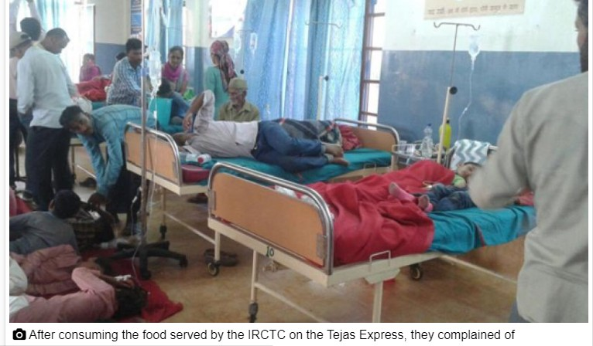
Major food poisoning at Tejas Express.12 out of 26 were affected

Slide 6
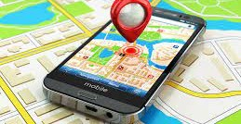

What's new
GPS
Getting latitude and longitude Using GEOCODER to convert latitude and longitude into street addresses. It will show stations which are one hour away from our current location.

Slide 7
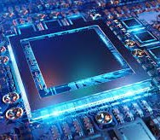

Hardware Requirements
Requirements Specification
System: Pentium IV 2.4 GHz Hard Disk: 8 GB
Monitor: 15 VGA Color RAM: 2 GB
Software Requirements
Operating system: Windows Coding language: Android SDK
Toolkit: Android 5.0 IDE: Eclipse

Slide 8
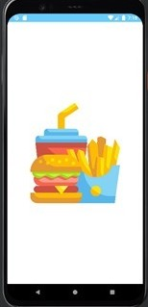
Flash Screen
A Opening flash screen appears for 2 seconds.

Slide 9
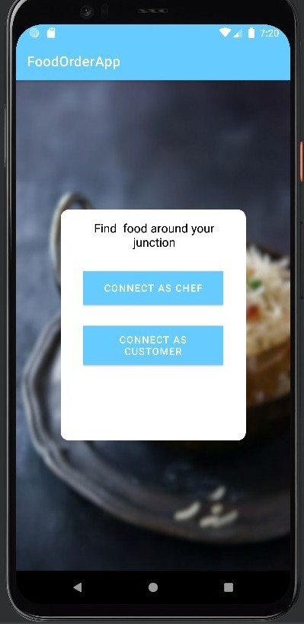
Customer or Chef

Slide 10
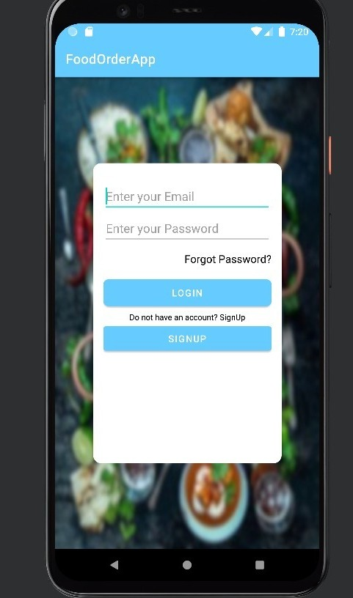
Login Page
Customers can log in to the app by using an email id and password if the customer already exists. If the customer is new they can register and log in to app.

Slide 11
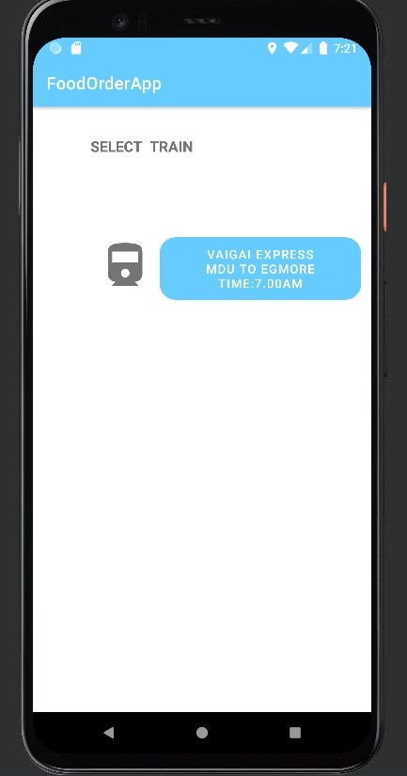
Select Train
As of now, we have created only one train which is from Madurai to Chennai.

Slide 12
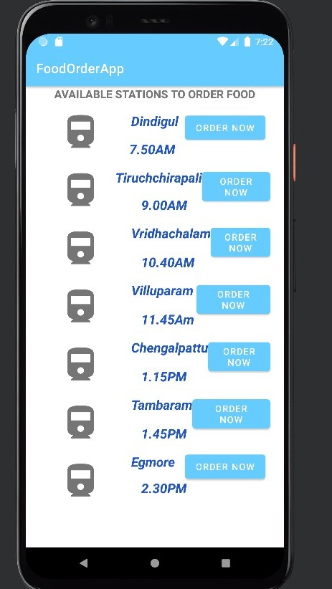
Select Station
when the train is selected the GPS starts its work. It basically gets the location of us i.e. the district in which our train is passing by it
shows the places which are at least 1 hour away from our current
district i.e.

Slide 13
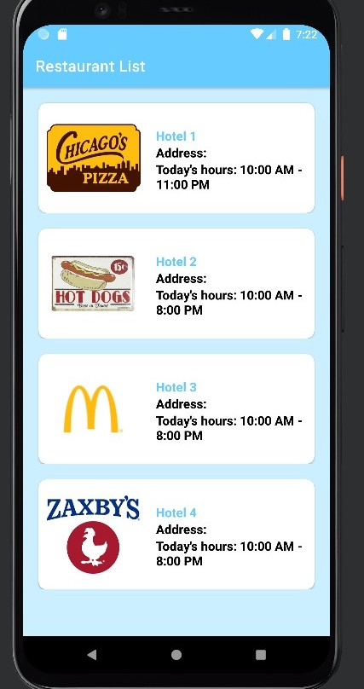
Select Hotel
Customers can select their favorite hotel in the upcoming station

Slide 14
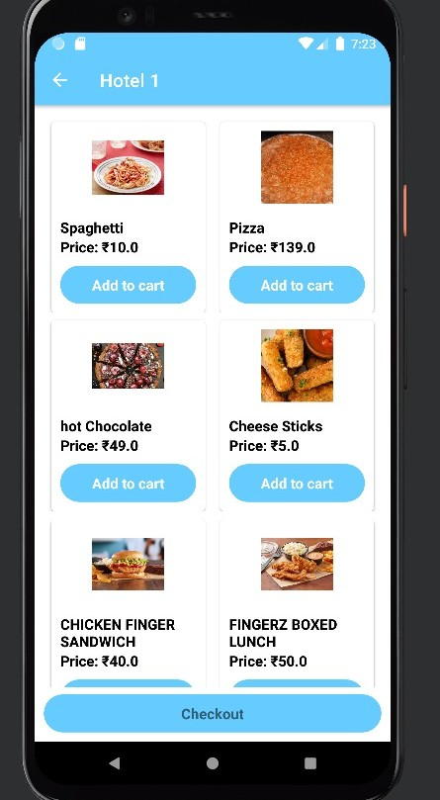
Menu Page
Customers can add their favorite item to cart

Slide 15
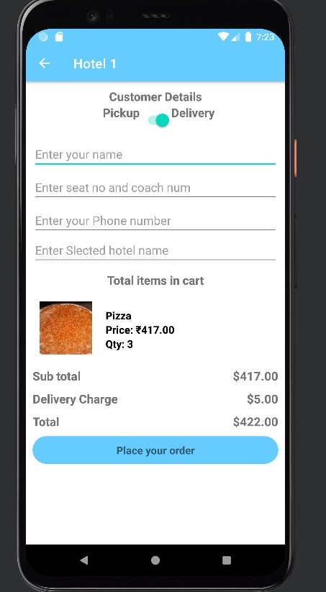
Place the Order
Customers can place an order by entering their details.

Slide 16
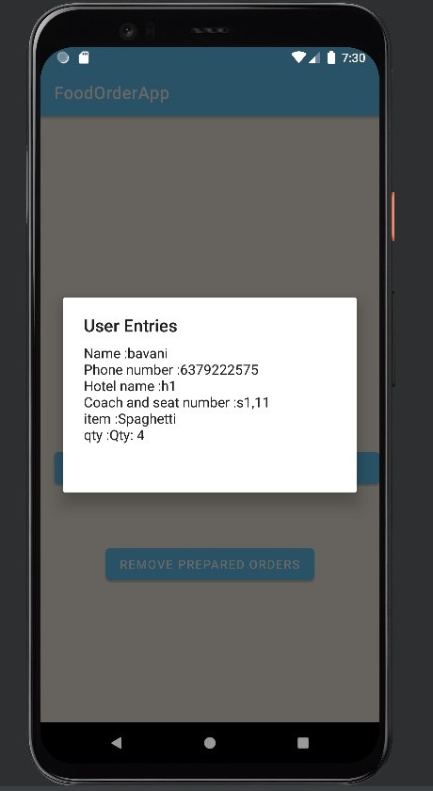
Customer Details
Restaurants can view the customers ordered details

Slide 17

Conclusion
We focused on the problems faced by the passengers who are traveling by train and developed this android application to overcome the causes affecting the people. We used these results to determine the usage of this application is very easy and everyone can make use of it by ordering their desired food at any place at any time. Main Moto to develop this app is to help the passengers to have a healthy food.

Slide 18


